Slide 1

Introduction to Project Management
Notes:
Everything we do consists of projects – from simple things like repairs on a car to more complex things like building a house, to IT projects like upgrading hardware, infrastructure, revamp of web servers, etc.
Even planning a trip. Do you need a passport/visa? Will you stay in an all inclusive resort?
NEEDS TO BE PLANNED OUT TO BE SUCCESSFUL. Price Waterhouse estimates over ½ of IT projects fail; only 2.5% meet scope, time and cost goals. The 1995 CHAOS study (Standish) says 16.2% of projects do not meet scope, time, and cost goals and over 31% were canceled before completion.

Slide 2




Why IT Project Management?
Global Technology Spending 3.5 trillion 2017 up 2.9% from 2016
Dependent on Technology
Size, complexity & number
PMI estimates 15.7 million PM jobs to 2020 with 6.2 million in the US
Notes:
Projects are part of our every day lives and require managing trade offs to get everything needed, in allotted time with allotted money.
Companies are now VERY depended for their success by how successful project are managed.
Because of the Size, Complexity, and Number of IT projects, organizations face ever-increasing challenges – the biggest area are mobile devices, network equipment, and storage devices. Demand is high because of mobile, cloud and mandated EMRs (electronic medical records).
U.S. government spends $2.3 trillion on projects every year for 25% of the nation’s gross domestic project.
Even in this tight economy, IT spending continues…not at the same pace but it is picking up.
Worldwide IT spending was $3.8 trillion in 2014, a 3.2 percent increase from 2013 spending
The Project Management Institute estimates demand for 15.7 million project management jobs from 2010 to 2020, with 6.2 million of those jobs in the United States

Slide 3
Importance of Project Management
20-30% IT Budget
Rapid Change
Top Skills Needed
Waste 109 million for every $1 billion IT Budget
Notes:
Forrester Research estimates that about 20 percent of current IT budgets are going into project development – can you confirm that today?
Rapid change leads to changing skills sets; costly to find and pay for required talents
It is estimated that over half of IT projects fail…this leads to companies looking at what is going wrong.
2013 PMI Salary survey – Autralia 134658, Switzerland 133605 and US 108000.
The top skills employers look for in new college graduates are all related to project management: team-work, decision-making, problem-solving, and verbal communications
Organizations waste $109 million for every $1 billion spent on projects, according to PMI’s Pulse of the Profession® report

Slide 4







Advantages of Using Formal Project Management Practices
Cost Return Investment
Customer Satisfaction
Schedules/Controls
Quality
Deliverables
Notes:
Improvement in customer satisfaction
Better cost performance, higher return on investment, better control human resources.
Better schedule performance, better allocation of time commitments and better utilization of resources, higher productivity
Increased quality reducing re-work and increased reliability
Increase in delivering required features
Will make everyone happier (stakeholders, team members, management…) higher worker morale
Better internal coordination

Slide 5
IT Projects Are Different
Category Engineering/ Information
Construction Technology
Requirements changes
Source of changes
Requirements
Uniqueness
Resources
Implementation
Testing
Slow, incremental
Known, predictable
Explicit plan
Higher commonality
Stable
Structured, controlled
Defined, measureable
Rapid, unplanned
Not Known
Ambiguous
Low commonality
High turnover rates
Often chaotic
Difficult to test
Notes:
High turnover rates of IT workers
Level of uniqueness and complexity of each project due to the rapid changes in technology
Software is hard to visualize by the developer let alone the customer
Difficulty in getting accurate customer requirements
Rate of change in requirements
Difficulty in testing all the possible states of software
Constant training needed to keep team members current with the technology

Slide 6
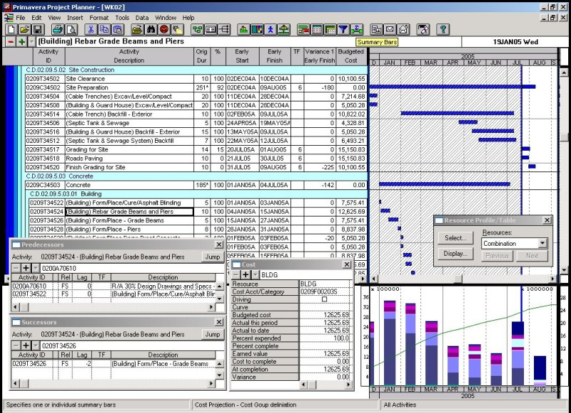
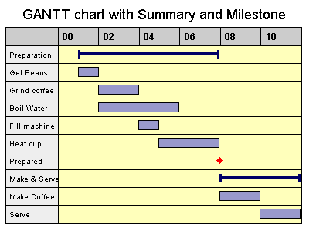
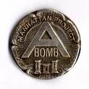
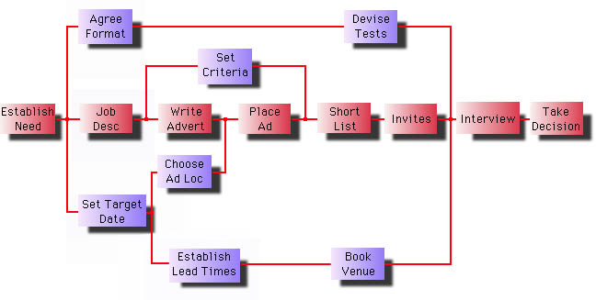
History of Project Management
Bottom line is the need for a systematic process on complex projects
Notes:
Modern project management began with the Manhattan Project, which the U.S. military led to develop the atomic bomb
In 1917 Henry Gantt developed the Gantt chart as a tool for scheduling work in job shops
In 1958, the Navy developed PERT charts (program evaluation and review technics
In the 1970s, the military began using project management software, as did the construction industry
By the 1990s, virtually every industry was using some form of project management
Bottom line is the need for a systematic process to review all the components of the process and to think things through especially with complex projects. Today we deal with extreme project mgt as rapid change

Slide 7
What Is a Project?
A temporary sequence of related activities that must be completed to create a unique product or service
Key Characteristics:
  Temporary
  Unique (purpose)
  Progressive Elaboration (occurs in steps or phases)
  Requires resources
  Sponsor or stakeholder
  Uncertainty (risk)
Notes:
Temporary It must have a beginning and an end
A project is done when one of the following occurs:
The project’s objectives have been achieved, as agreed by the sponsor
It has been determined that the project’s objectives will not or cannot be achieved
The need for the project no longer exists, and the project is terminated
Unique
Never been done before
Must contain a well-defined purpose
Because each project is unique, creates uncertainty and risk
Progressive elaboration
Refers to the idea that execution of the project occurs in steps (phases) or small increments, adding features and definition until the final objective is achieved
Concept applies to the scope, time, and cost of the project
Secondary Characteristics:
Each project must have a primary sponsor or champion
Projects usually cut across organizational lines requiring resources from several different sources
They must do something, deliver something of value

Slide 8
Some Top Strategic Technologies
Mobile device diversity & management
Mobile-centric applications & interfaces
Contextual & social user experiences
Internet of everything
Hybrid cloud & IT as a Service broker
Cloud/Client architecture
Era of personal cloud
Software defined anything
Web-Scale IT
Smart Machines
3-D printing
AI and drones

Slide 9

A Project Manager Manages
Projects by:
Setting clear and achievable objectives
Identifying requirements
Adapting the project to the various concerns of the stakeholders
Balancing the demands of the triple constraint
Notes:
What is the purpose of this project? What are its goals?
What will be done as part of this project?
What do the stakeholders envision?
How do I balance all of those?

Slide 10
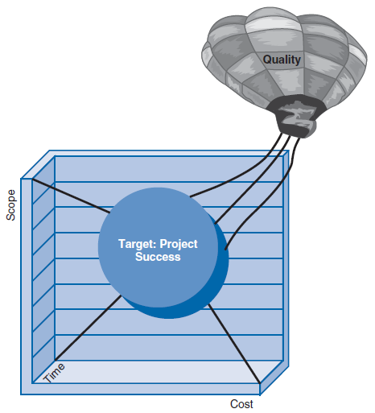
The Triple Constraint
Scope
Time/cost
Time
Cost
Scope
Cost
Scope
Time
Notes:
Every project is constrained by a list of customer-requested requirements (scope), the amount of time available to produce the system in support of the requirements (time), and the limit of money available (cost)
Every project is constrained differently, according to the goals of the system owner (sponsor) and the project team
Reducing time allowed will increase cost (especially if overtime is required) and may reduce the scope (functions and features) of the system
Reducing costs (cutting the budget) will increase time (delay schedule) and may reduce the scope (functions and features) of the system
Increasing scope (adding features) will certainly increase time and/or cost
Reducing scope may reduce time and cost (and it may also negatively affect quality)

Slide 11
What is Project Management?
The application of knowledge, skills, tools, and techniques to project activities to meet project goals and requirements.

Slide 12
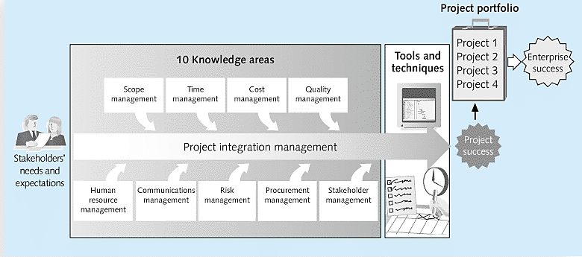
Project Management Framework

Slide 13
Project Manager Skills
Soft skills:
  Leadership
  Team building
  Negotiation
  Conflict management
  Organization for self and others
  Communication both oral and written to both technical and non-technical audiences
  Change management
  Active listening
Technical Skills:
  Project Management software
  Level of understanding of the technology being used in the project (software, hardware, network, etc.)
  Basic knowledge of the business
  Cost estimating and budgeting

Slide 14
Project Management Tools and Techniques
Project management tools and techniques assist project managers and their teams in various aspects of project management
Some specific ones include
  Project charter, scope statement, and WBS (scope)
  Gantt charts, network diagrams, critical path analysis, critical chain scheduling (time)
  Cost estimates and earned value management (cost)
  See Table 1-1 for many more
Notes:
“Super tools” are those tools that have high use and high potential for improving project success, such as:
Software for task scheduling (such as project management software)
Scope statements
Requirements analyses
Lessons-learned reports
Tools already extensively used that have been found to improve project importance include:
Progress reports
Kick-off meetings
Gantt charts
Change requests

Slide 15
Project Success
On time, on budget and within scope
Satisfied stakeholders
Objectives met
Executive support
User involvement
Experienced PM
Clear business objectives
Formal methodology; tools and infrastructure
Reliable estimates; scope constraints
Notes:
Standish Group’s CHAOS studies show improvement in IT projects with the use of Project Management tools and techniques.
Number of successful projects went from 16% in 1994 to 39% in 2012
The number of failed projects decreased from 31% to 18% during that same time period
Successful rates were much higher for small projects than larger ones – 76% versus 10%

Slide 16
What the Winners Do…
Recent research findings show that companies that excel in project delivery capability:
  Use an integrated project management toolbox (use standard/advanced PM tools, lots of templates)
  Grow project leaders, emphasizing business and soft skills
  Develop a streamlined project delivery process
  Measure project health using metrics, like customer satisfaction or return on investment

Slide 17
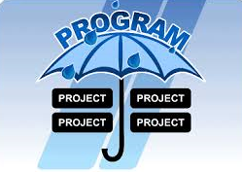
Project and Program Managers
Notes:
Project managers work with project sponsors, project team, and other people involved in a project to meet project goals
Program: group of related projects managed in a coordinated way to obtain benefits and control not available from managing them individually (PMBOK® Guide, Fifth Edition, 2012)
Program managers oversee programs; often act as bosses for project managers

Slide 18
Program and Project Portfolio Management
A program is “a group of related projects managed in a coordinated way to obtain benefits and control not available from managing them individually”
A program manager provides leadership and direction for the project managers heading the projects within the program
Examples of common programs in the IT field include infrastructure, applications development, and user support

Slide 19
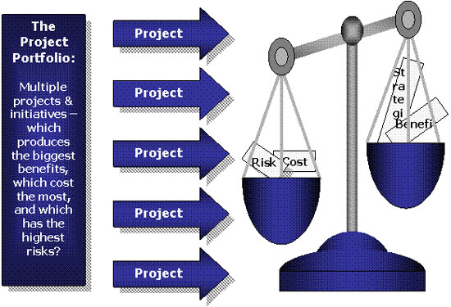
Program/Project
Portfolio Management

Slide 20
Project Portfolio Management
As part of project portfolio management, organizations group and manage projects and programs as a portfolio of investments that contribute to the entire enterprise’s success
Portfolio managers help their organizations make wise investment decisions by helping to select and analyze projects from a strategic perspective

Slide 21
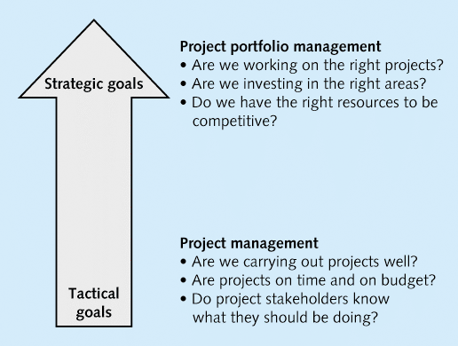
Figure 1-3. Project Management Compared to Project Portfolio Management

Slide 22
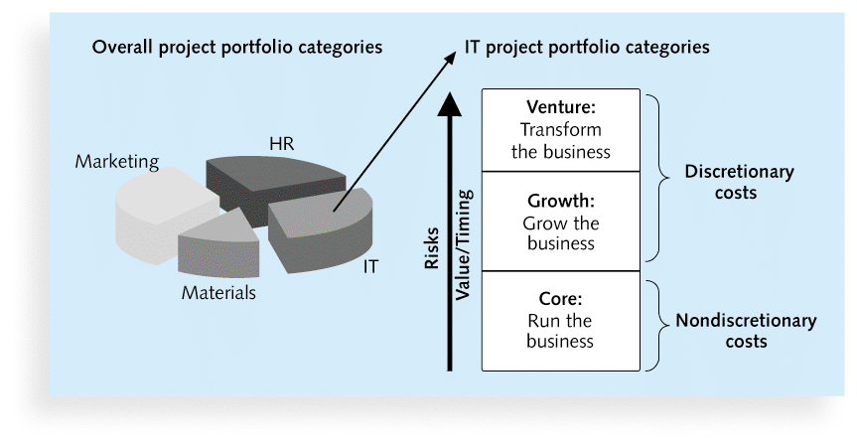
Figure 1-4. Sample Project Portfolio Approach

Slide 23
10 Most Important PM Skills
1. People skills
2. Leadership
3. Listening
4. Integrity, ethical behavior, consistent
5. Strong at building trust
6. Verbal communication
7. Strong at building teams
8. Conflict resolution, conflict management
9. Critical thinking, problem solving
10. Understands, balances priorities
Notes:
What do you find interesting about his list?
Would you agree that skills sets vary based on type of project?
Large projects: Leadership, relevant prior experience, planning, people skills, verbal communication, and team-building skills were most important
High uncertainty projects: Risk management, expectation management, leadership, people skills, and planning skills were most important
Very novel projects: Leadership, people skills, having vision and goals, self confidence, expectations management, and listening skills were most important

Slide 24

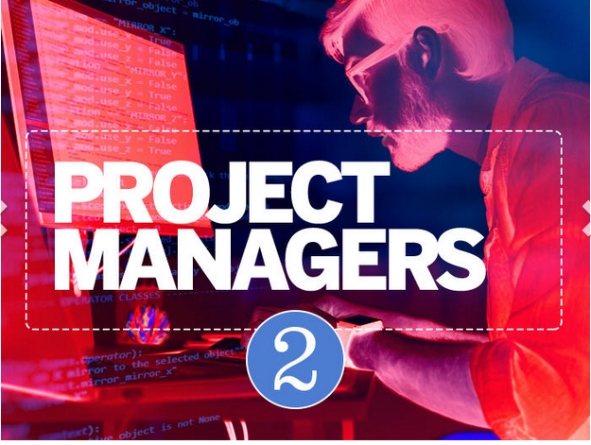








Ten Hottest IT Skills*
Notes:
1. Full stack software developers -

Slide 25
Ten Hottest Skills 2015*
Skill | % of Respondents Hiring | 2012 Ranking
Programming & application dev | 48% | 1
Project management | 35% | 5
Help desk/technical support | 30% | 2
Security/Compliance governance | 28% | 7
Web Development | 28% | Not Ranked
Database Administration | 26% | 6
Business Intelligence/Analytics | 24% | 8
Mobile Apps/Device Dev | 24% | 4
Networking | 22% | 3
Big Data | 20% | 11
*Source: Mary Pratt, “10 Hot IT Skills for 2015,” Computerworld, November 18, 2014.
Notes:
http://www.computerworld.com/article/2844020/10-hottest-it-skills-for-2015.html

Slide 26
Ten Hot Tech Skills 2017*
Skill | Percentage of Respondents Hiring | 2015 Ranking
Programming and application development | 35% | 1
Help desk/tech support | 35% | 3
Security/compliance/governance | 26% | 4
Cloud/SaaS | 26% | Not ranked
Business Intelligence/Analytics | 26% | 6
Web Development | 26% | 4
Database administration | 25% | 5
Project management | 25% | 2
Big Data | 25% | 8
Mobile applications and device management | 21% | 6
*Source: Mary Pratt, “10 Hot IT Skills for 2017,” Computerworld, December 7, 2016
Notes:
http://www.computerworld.com/article/3147427/it-skills-training/10-hottest-tech-skills-for-2017.html
http://www.computerworld.com/article/3149734/it-management/tech-forecast-2017-facts-and-figures-for-the-year-ahead-in-it.html#slide1
Missing ie not ranked 2017 but coming in 7th 2015 was Networking

